Slide 1
Create different type of Repors
Tableau Desktop:
Tableau Online:
Publishing different type of Reports
Tableau Server:
Tableau Reader:
Tableau Public:
Database Support
Spreadsheet
Database
BigData
Access Data warehouses
Cloud Applications
Cloud Databases
50 + Different databases
Publish Report
Desktop
Tablet
Mobile

Slide 2
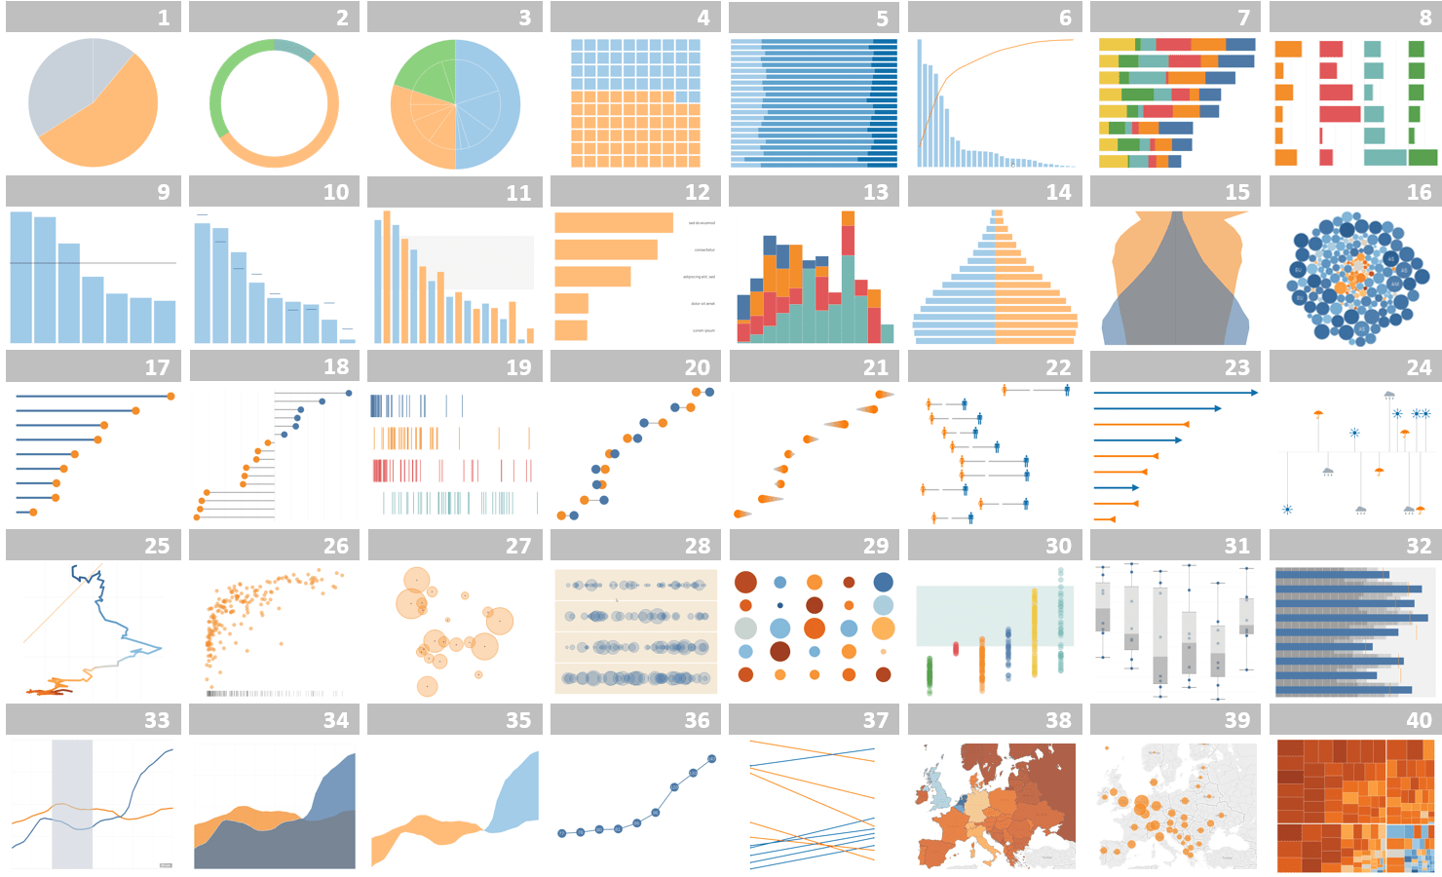
Different type of charts

Slide 3
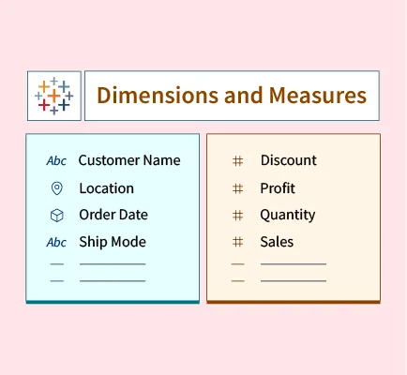
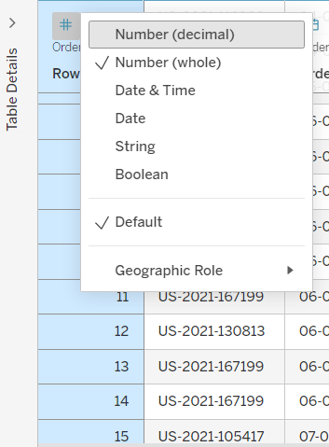

Slide 4
Table
Column Formatting
Renaming
Copy and Paste column
Splitting (Split and Custom Split)
Hide and Unhide
Sorting
Grouping data
Pivoting data
Combine
Handling Null Values

Slide 5
Different Charts
Chart Type Best For Example Use
Bar Chart Comparing categories Sales by region
Line Chart Trends over time Monthly revenue growth
Pie Chart Part-to-whole comparison Market share
Area Chart Cumulative trends Traffic growth over time
Dual Axis Chart Comparing two measures Revenue and profit margin
Waterfall Chart Incremental changes Profit breakdown
Funnel Chart Stage conversion analysis Sales pipeline
Scatter Plot Relationship between variables Profit vs Sales
Donut Chart Styled part-to-whole view Expense allocation
Heat Map Density/intensity comparison Website clicks by hour
Map Chart Geographic analysis Sales by state/country
Box Plot Spread and outliers Salary distribution
Histogram Distribution of values Customer age distribution
Highlight Table Color-coded comparison Regional performance matrix
Bullet Chart Performance vs target KPI dashboards
Packed Bubbles Relative size comparison Brand popularity
Gantt Chart Project timelines Task schedules
Tree Map Hierarchical proportions Product category contribution

Slide 6
Dashboard
Sorting
Quick Sort
Sort from tool bar
Sort from pil
Hierarchy(Drill Up,Drill Down)
Pivot in View
Filtering
Data Source Filters
Filter Shelf
Interactive Filters
Headers Filters
Legends Filters
Advance Filters
Sets
Parameters
Sets with Parameters
Table Calculations
Creating calculated fields (basic)

Slide 7
Data Modelling and Joins
Joins :
Inner, Left, Right, Full
Relationships (Logical Layer):
The modern "Noodle" approach. It doesn't merge tables into a single flat file; instead, it keeps tables separate and joins them only at the time of analysis based on the context of your viz.
Relationships vs. Joins:
Joins merge tables into a single fixed physical table upfront, while Relationships describe how separate tables connect dynamically based on the context of your analysis.
Blending :
Used when data resides in two different data sources. It mimics a left join but aggregates the data before combining it.
Union :
Appends rows from one table to another (stacking data vertically).
Cross-Database Joins:
This allows you to join tables from different platforms for example, joining a table from a SQL Server with a sheet from an Excel file into a single integrated data source.

Slide 8
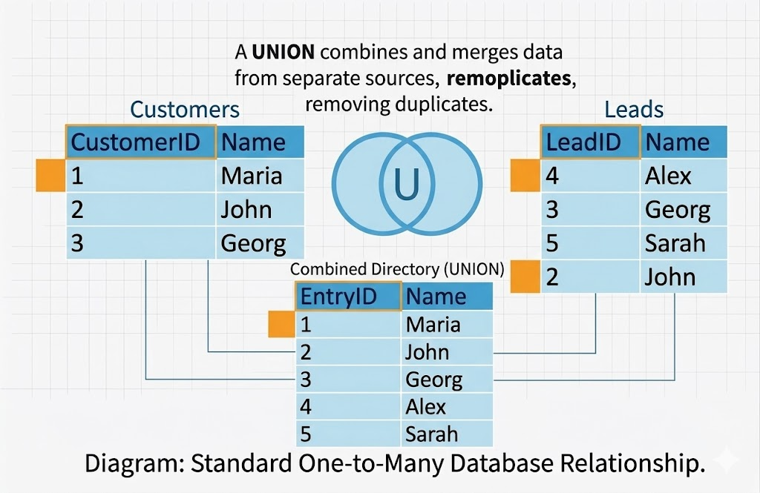

Slide 9
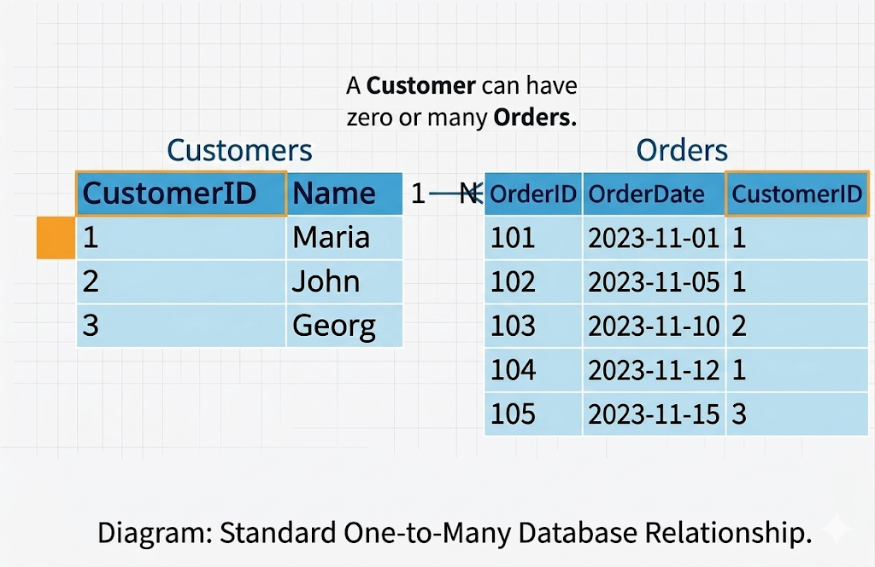

Slide 10
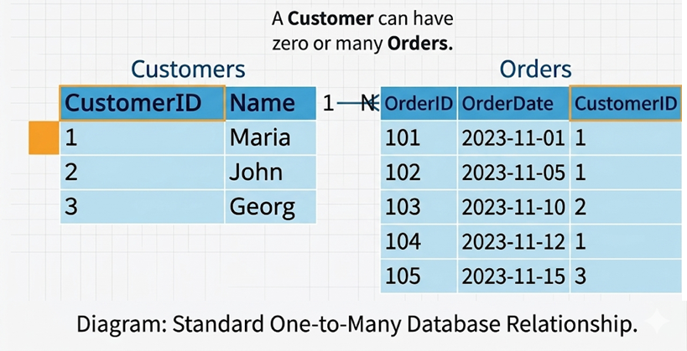
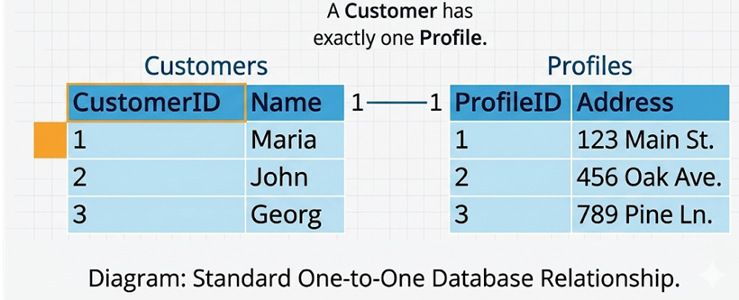

Slide 11
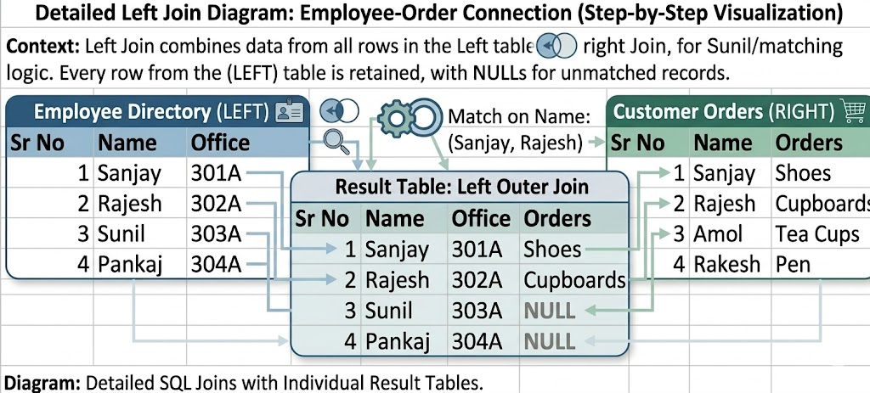
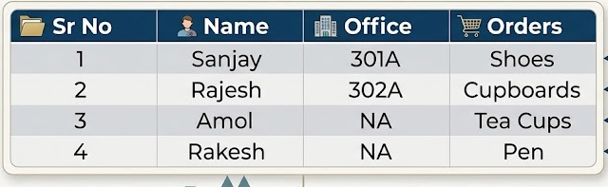

Slide 12
Calculations (Intermediate)
Calculated fields deep dive
Aggregate Functions
non-aggregate functions
String, date, and logical functions
Table calculations (running total, percent of total)
Quick table calculations
Advanced Calculations
Nested calculations
Conditional calculations
Level of Detail (LOD) expressions :
FIXED
EXCLUDE
INCLUDE
Window Functions
WINDOW_SUM, WINDOW_AVG, WINDOW_MIN, WINDOW_MAX
Ranking Functions
RANK, DENSE_RANK, RANK_MODIFIED, RANK_UNIQUE
Positional/Table Calc Functions
FIRST, LAST, INDEX, LOOKUP
Cohort analysis basics
Advanced Visualizations
Dual axis charts OR Combo charts
Maps (symbol, filled maps)
Highlight table OR heat maps
Parameters (dynamic control)

Slide 13
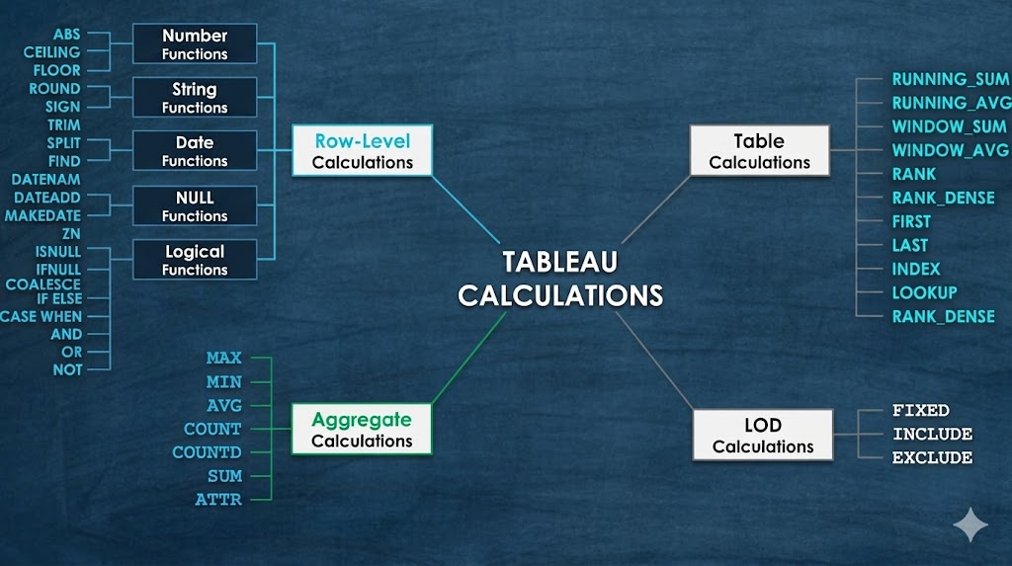

Slide 14
LOD:
Visualization will send query to the data source and data source will send the answer back.

Slide 15
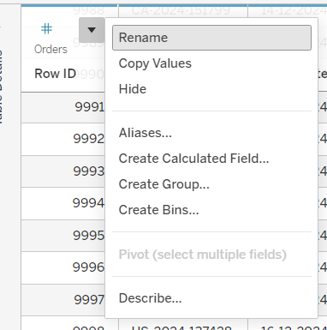

Slide 16
Live Vs Extract
Why to use Tableau
Speed
User-friendly
Beautiful and Interactive Dashboard
Direct Connection
Easy publishing and sharing
Growing Market

Slide 17
Data Preparation & Cleaning
Data Interpreter
Drill down and hierarchies
Measure Name and Measure Values
Usage of Measure Name and Measure Values
Discrete Vs Continous

Slide 19
Table One |  |  |  | Table Two
Sr No | Name | Office |  | Sr No | Name | Orders
1 | Sanjay | 301A |  | 1 | Sanjay | Shoes
2 | Rajesh | 302A |  | 2 | Rajesh | Cupboards
3 | Sunil | 303A |  | 3 | Amol | Tea Cups
4 | Pankaj | 304A |  | 4 | Rakesh | Pen
Outer Join
Sr No | Name | Office | Orders
1 | Sanjay | 301A | Shoes
2 | Rajesh | 302A | Cupboards
3 | Sunil | 303A | NA
4 | Pankaj | 304A | NA
3 | Amol | NA | Tea Cups
4 | Rakesh | NA | Pen

